Slide 1
FPGA Enhanced Wireless Sensor Node for IoT Applications
Mohammed Marjan
Jesse Esquivel
Irfan Malik
Logan Robson
Hung Tran
Ishak Nur
Faculty Supervisor
Dr. Jens-Peter Kaps

Slide 2
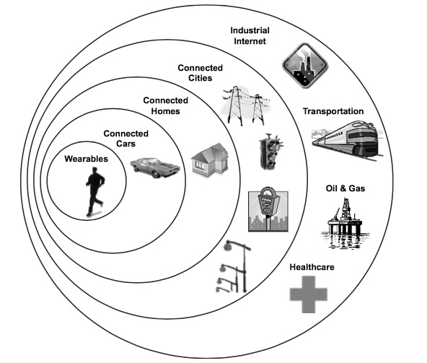
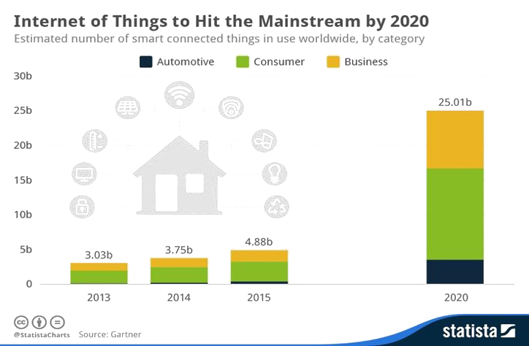
Internet of Things (IoT)
IoT is emerging as the third wave in the development of the Internet.
IoT is the global phenomenon that connects wearables, cars, homes and more all together.
By 2020, 25 billion devices will be connected to the Internet.
Notes:
How presentation will benefit audience: Adult learners are more interested in a subject if they know how or why it is important to them.
Presenter’s level of expertise in the subject: Briefly state your credentials in this area, or explain why participants should listen to you.

Slide 3
Hypothetical, but Possible…
Suppose:
An elderly person has a fully connected home, health monitoring wearables, and a pill reminder device.
Hacker gains control of device after figuring out its session key.
Increases and decreases medications.
Mistakenly modifies dosage as told.
Diabetic shock.
Ignores smart fridge’s advise to order new healthy foods.
Food advisor app fails, because there is no healthy food in fridge.
Missing vital nutrients, she may have a heart attack at home alone.

Slide 4
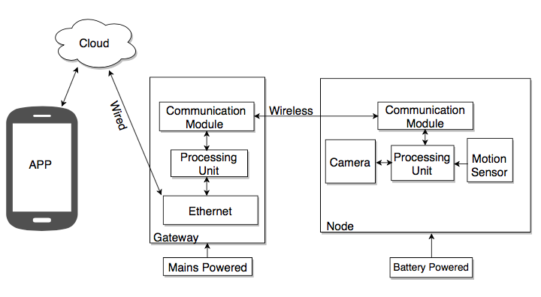
IoT Application (Our Use Case)
Design a motion triggered wireless security camera sensor node that interacts with a user via Smartphone app.

Slide 5
Requirements
Secure Communication
Data along channel is encrypted by a session key generated using a secure cryptographic algorithm.
Key Management
Key generation, exchange session key, and a rekeying functionality that renews session keys.
Long battery life
Low power device selection and efficient programming methods.
Reprogrammable
With an FPGA we can update our design and re-install crypto algorithms.
Easy Configuration
Easy and secure installation of nodes to the network.
Easy User Interface
Make app user friendly.

Slide 6
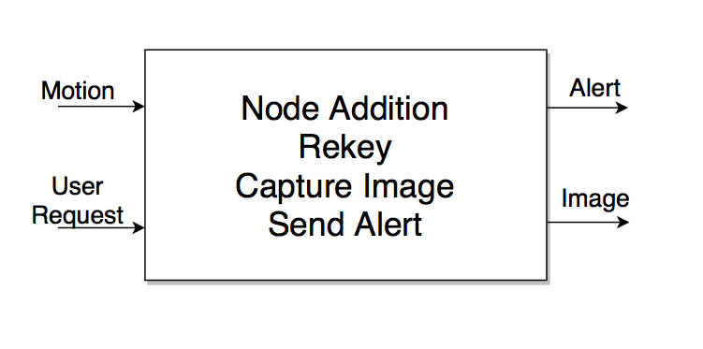
Top Level

Slide 7
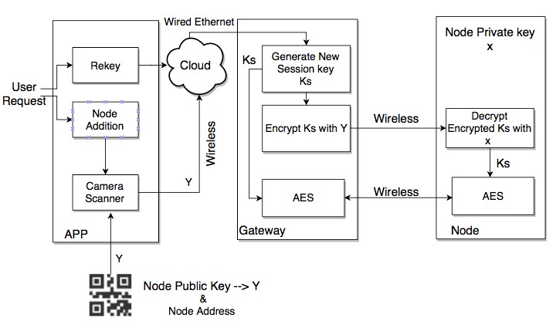
Node Addition & Rekeying

Slide 8
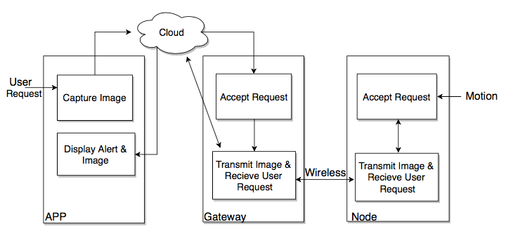
Motion & User Request

Slide 9
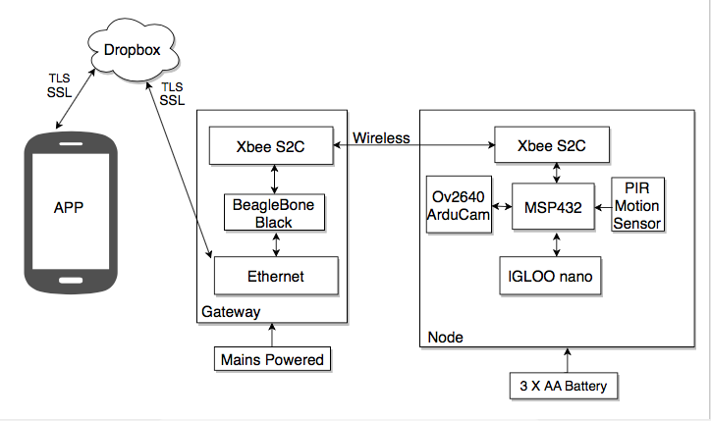
System Architecture

Slide 10
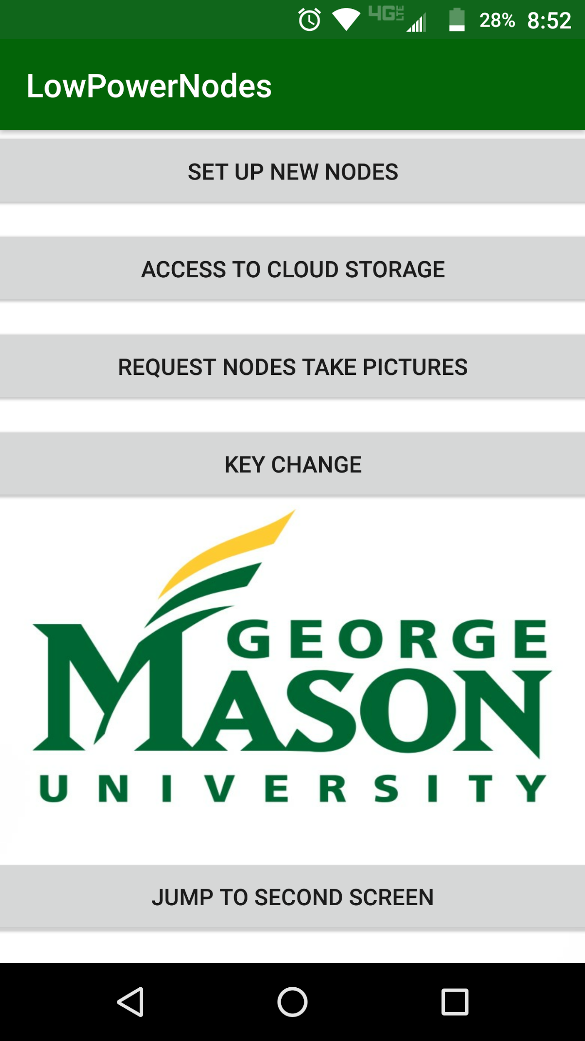
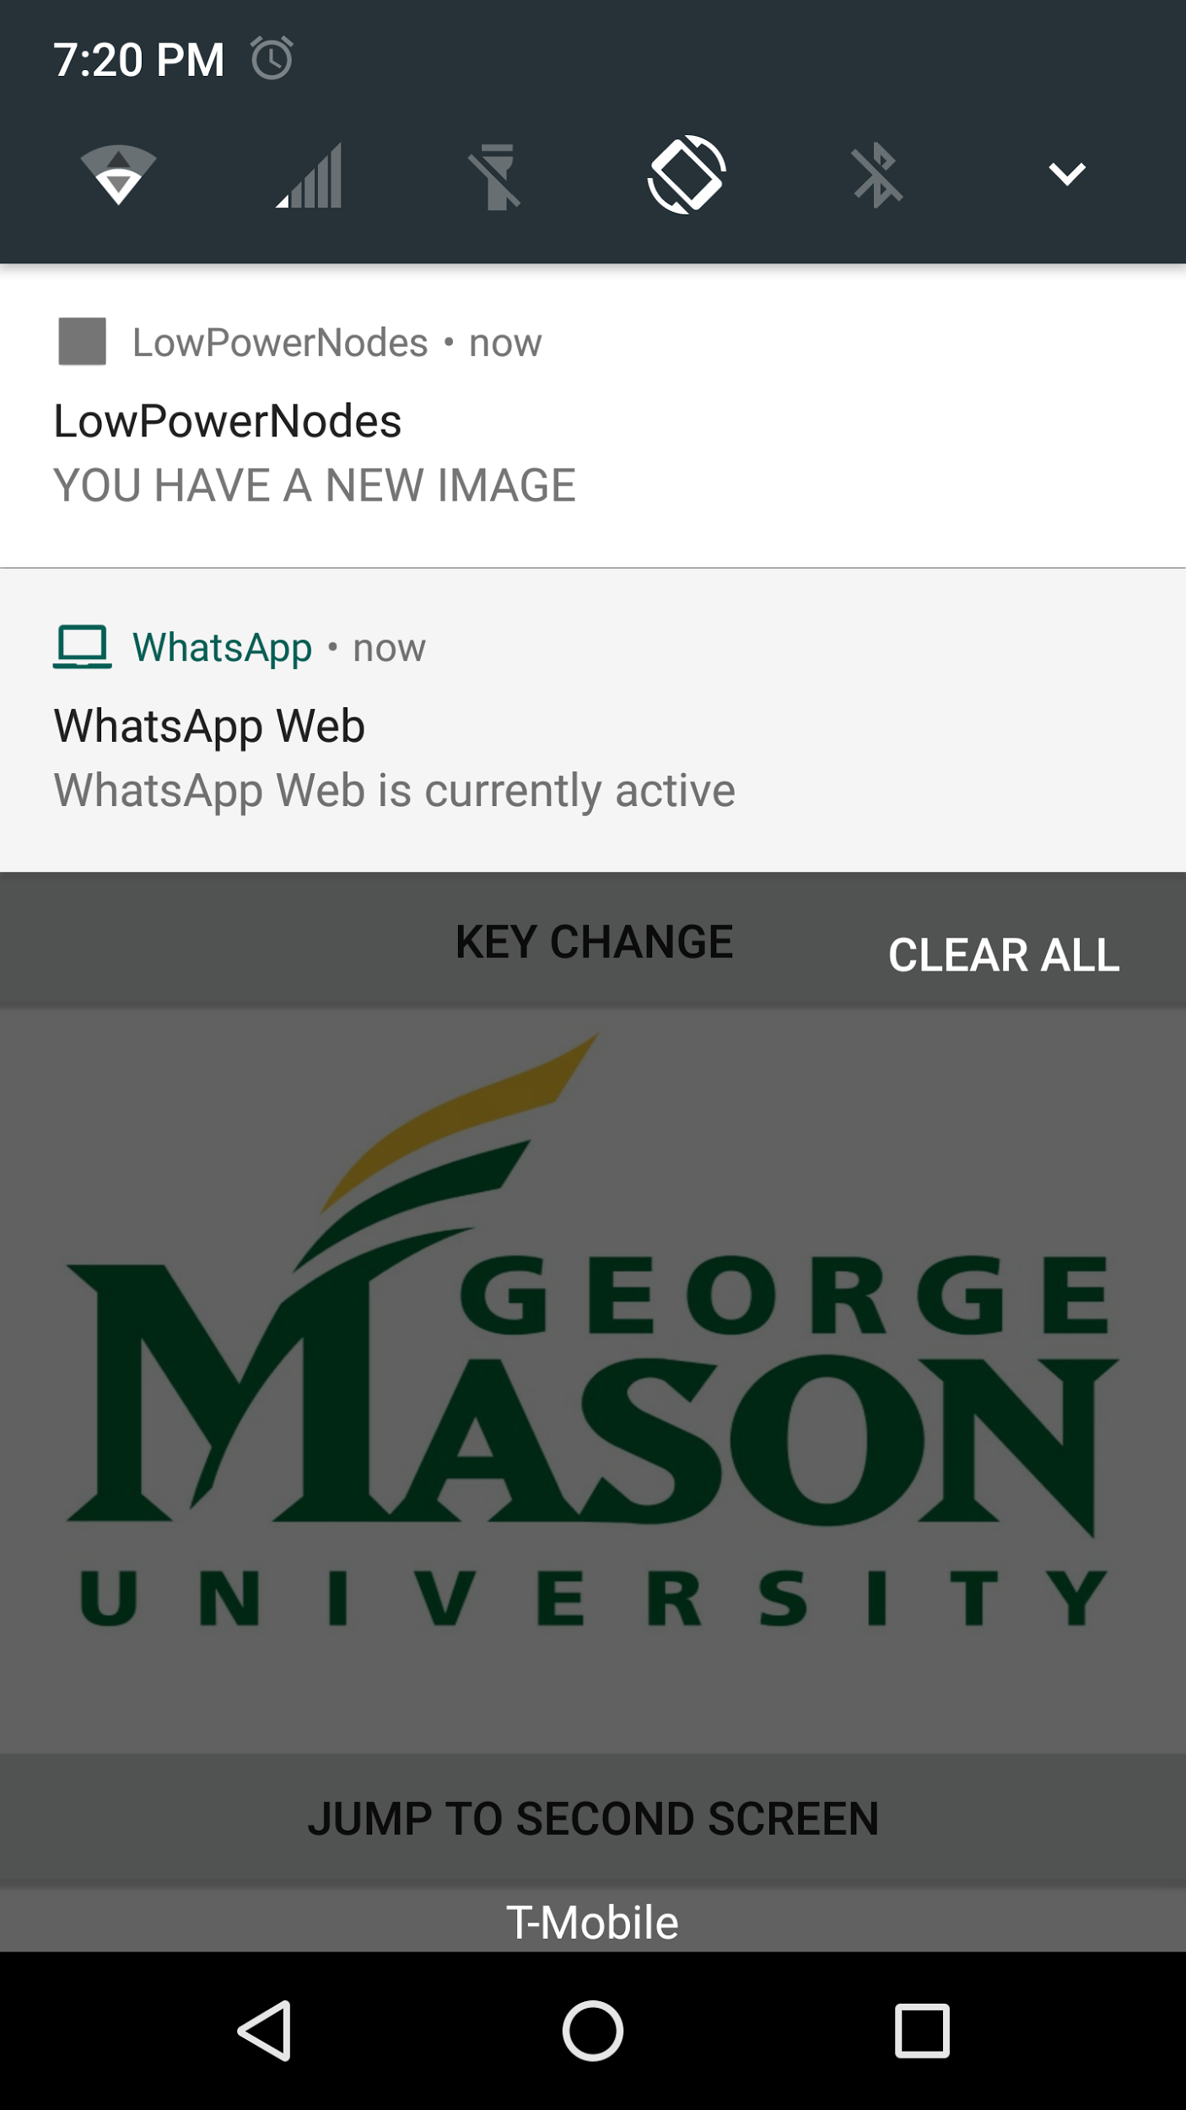
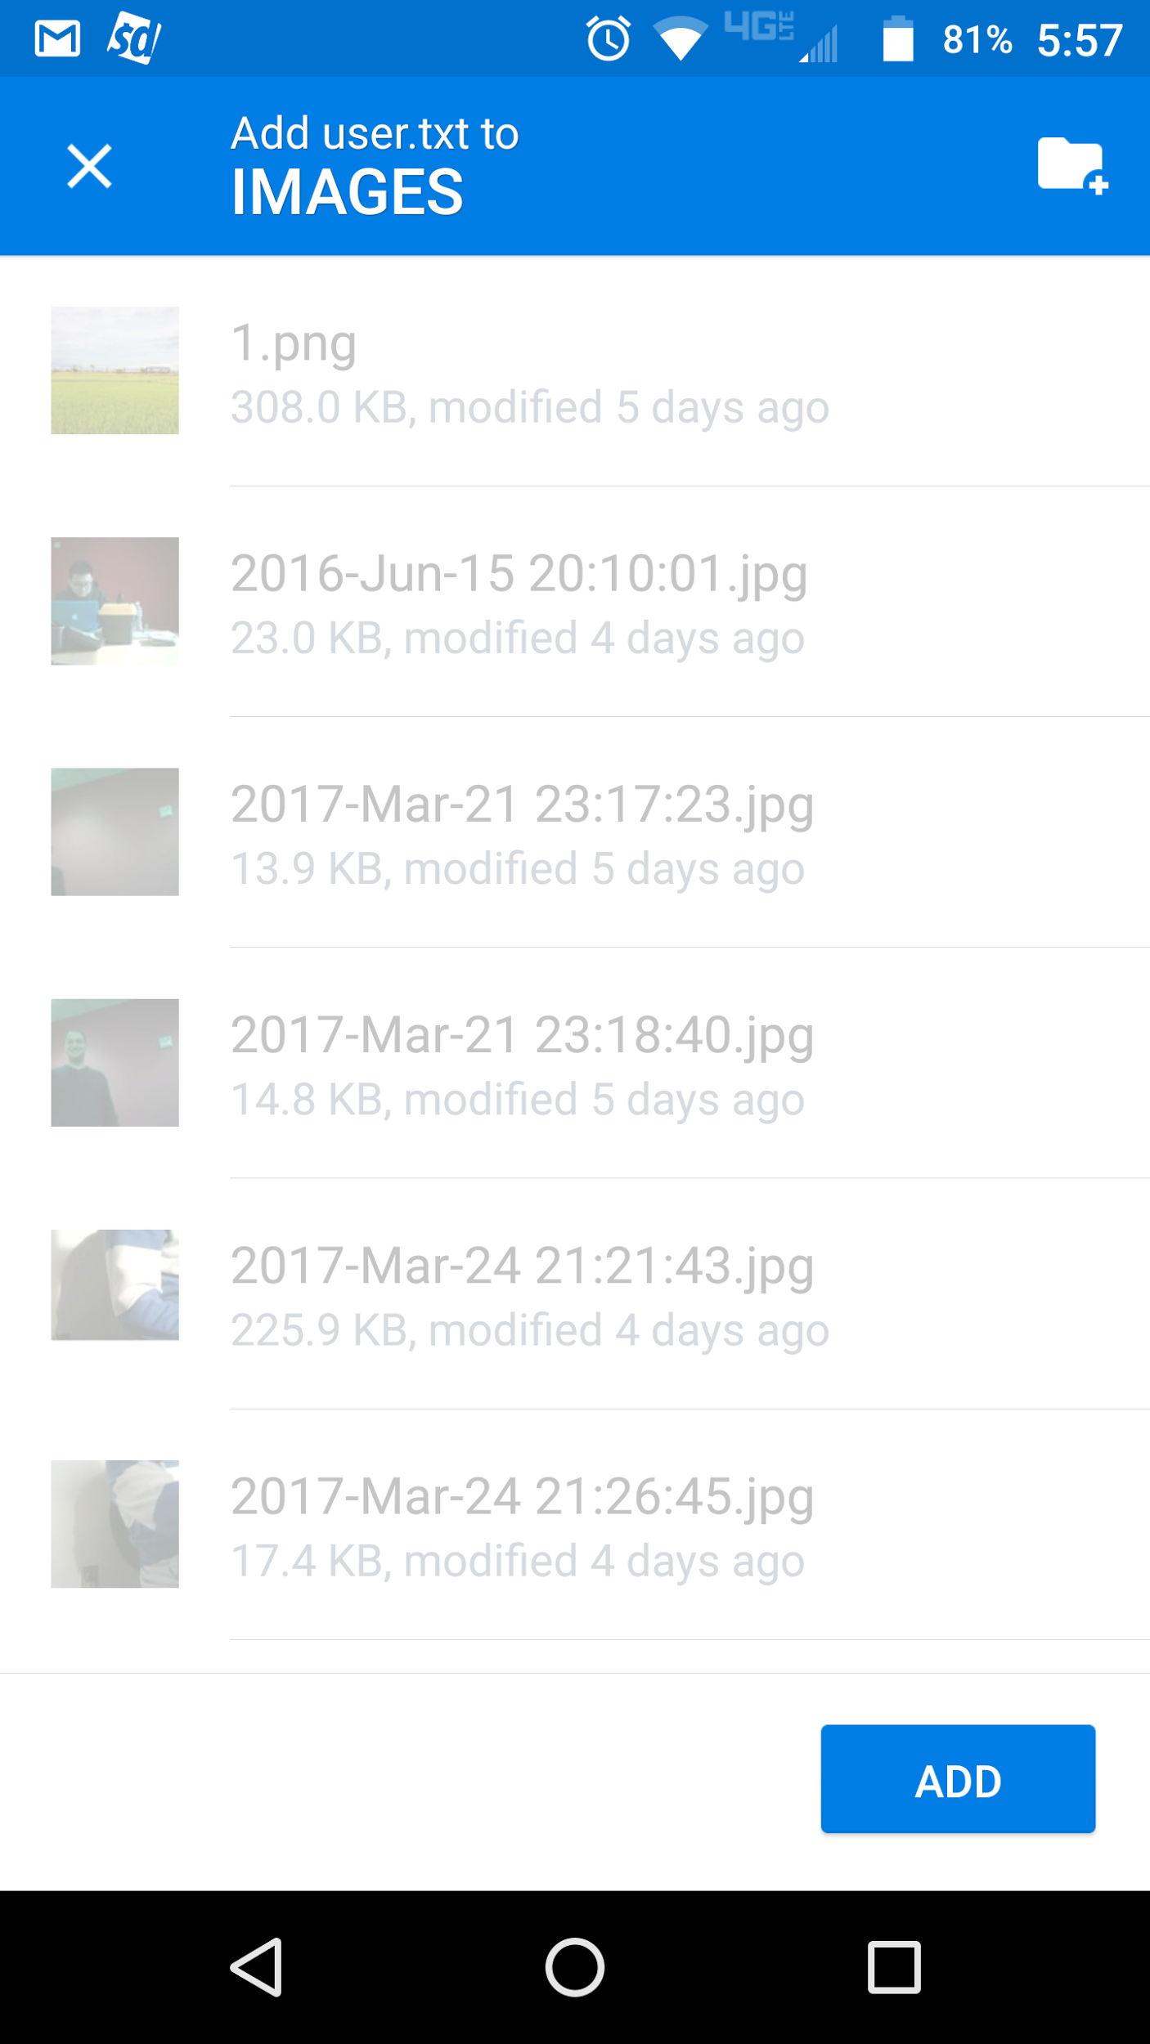
App Design
In app notification and text message alert
2 Layers
Four Buttons:
Set up new nodes.
Cloud access
User request
Session key change

Slide 11
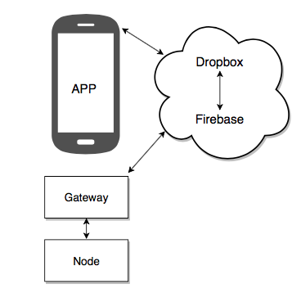
Cloud Backend
Cloud is the place to store data and images.
Dropbox is a multiway synchronization system(TCP, TLS and SSL transfer)
Support all OS such as MacOS, Linux, iOS
Firebase uses http and Extensible Messaging and Presence Protocol (XMPP)
Use Firebase cloud message (FCM) as in app push notification .

Slide 12
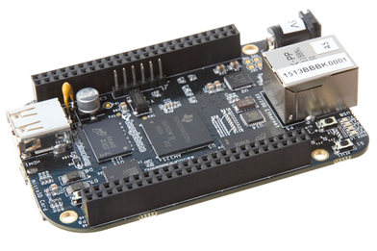
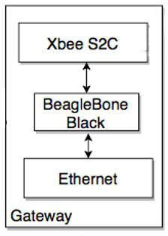
Gateway
We selected the BeagleBone Black to function as our gateway device
What is it used for ?
Connects the cloud to the node network
Executes user requests and handles image transfers to the cloud
Runs an El Gamal Scheme encryption algorithm using the node public key
Generates an encrypted session key which gets transferred to the node specified from the address obtained from the scanned QR code.

Slide 13
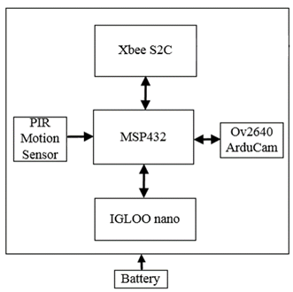
Node
• Main component of the node is the MSP432 microcontroller.
• MSP432 acts as the “central hub” in the node.
• Offers low power performance.
Camera - Arducam OV2640 2MP
• Availability, JPEG compression output
• Interfaces to the MSP432 via SPI and I2C
PIR - HC-SR501
• Cost, availability, ease of use
• Interfaces to the MSP432 via GPIO

Slide 14
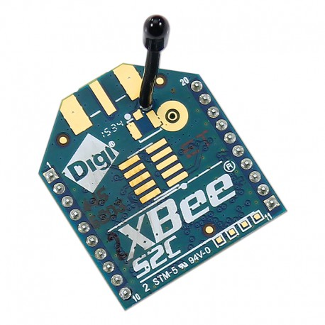
Node (cont.)
Wireless Communication – XBee X2C
• Zigbee 802.15.4 protocol to provide our communication between sensor nodes and gateway.
• Offers good combination of low power, security (AES), and performance.
• Interfaces with the MSP432 via UART and GPIO pins.

Slide 15
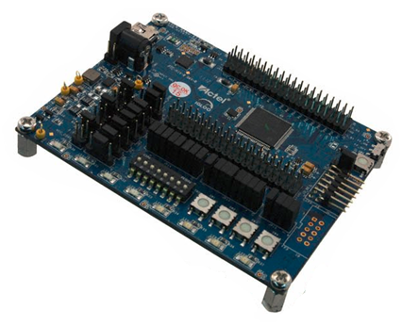
FPGA
ACTEL IGLOO nano AGLN250V2-VQG100
Low Power
Flash Based
El Gamal Scheme
Elliptic Curve Cryptography
Point Arithmetic
ECC Core(Provided by Ahmad Salman)
Computationally Heavy
Interfaces
MCU-to-FPGA: I2C(Modified)
Transmit/Receive Unit(Created)

Slide 16
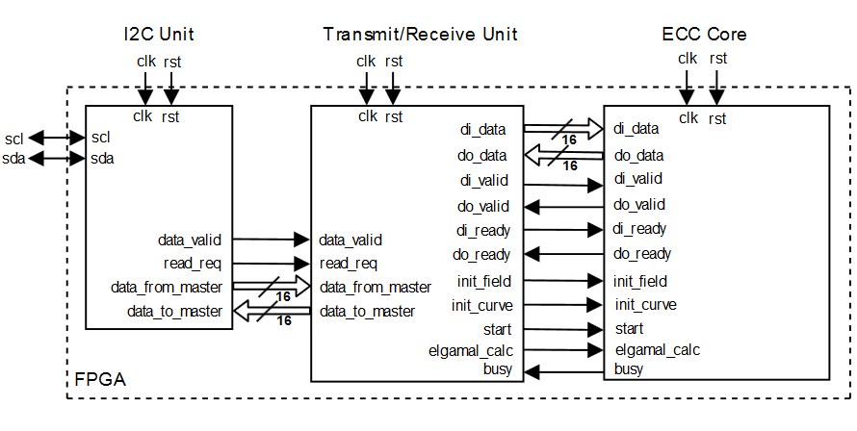
Block Diagram

Slide 17
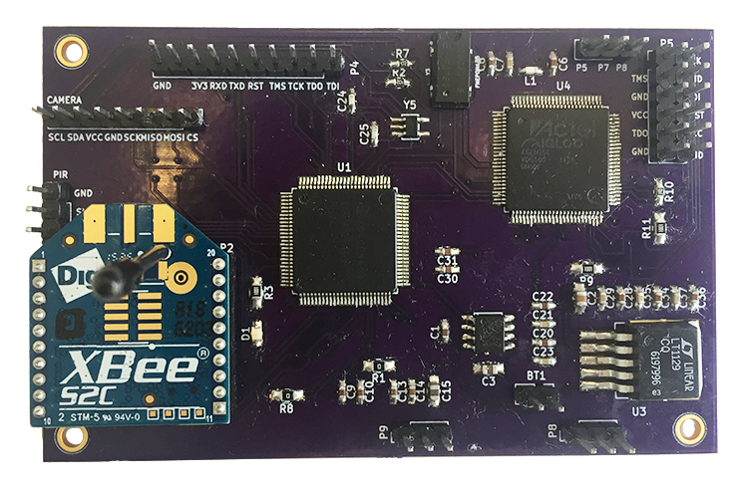
PCB

Slide 18
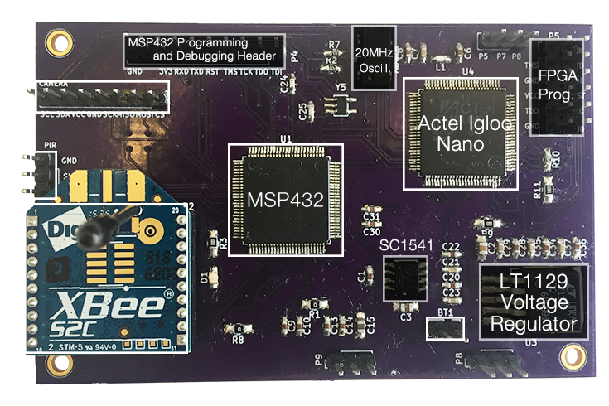
PCB

Slide 19
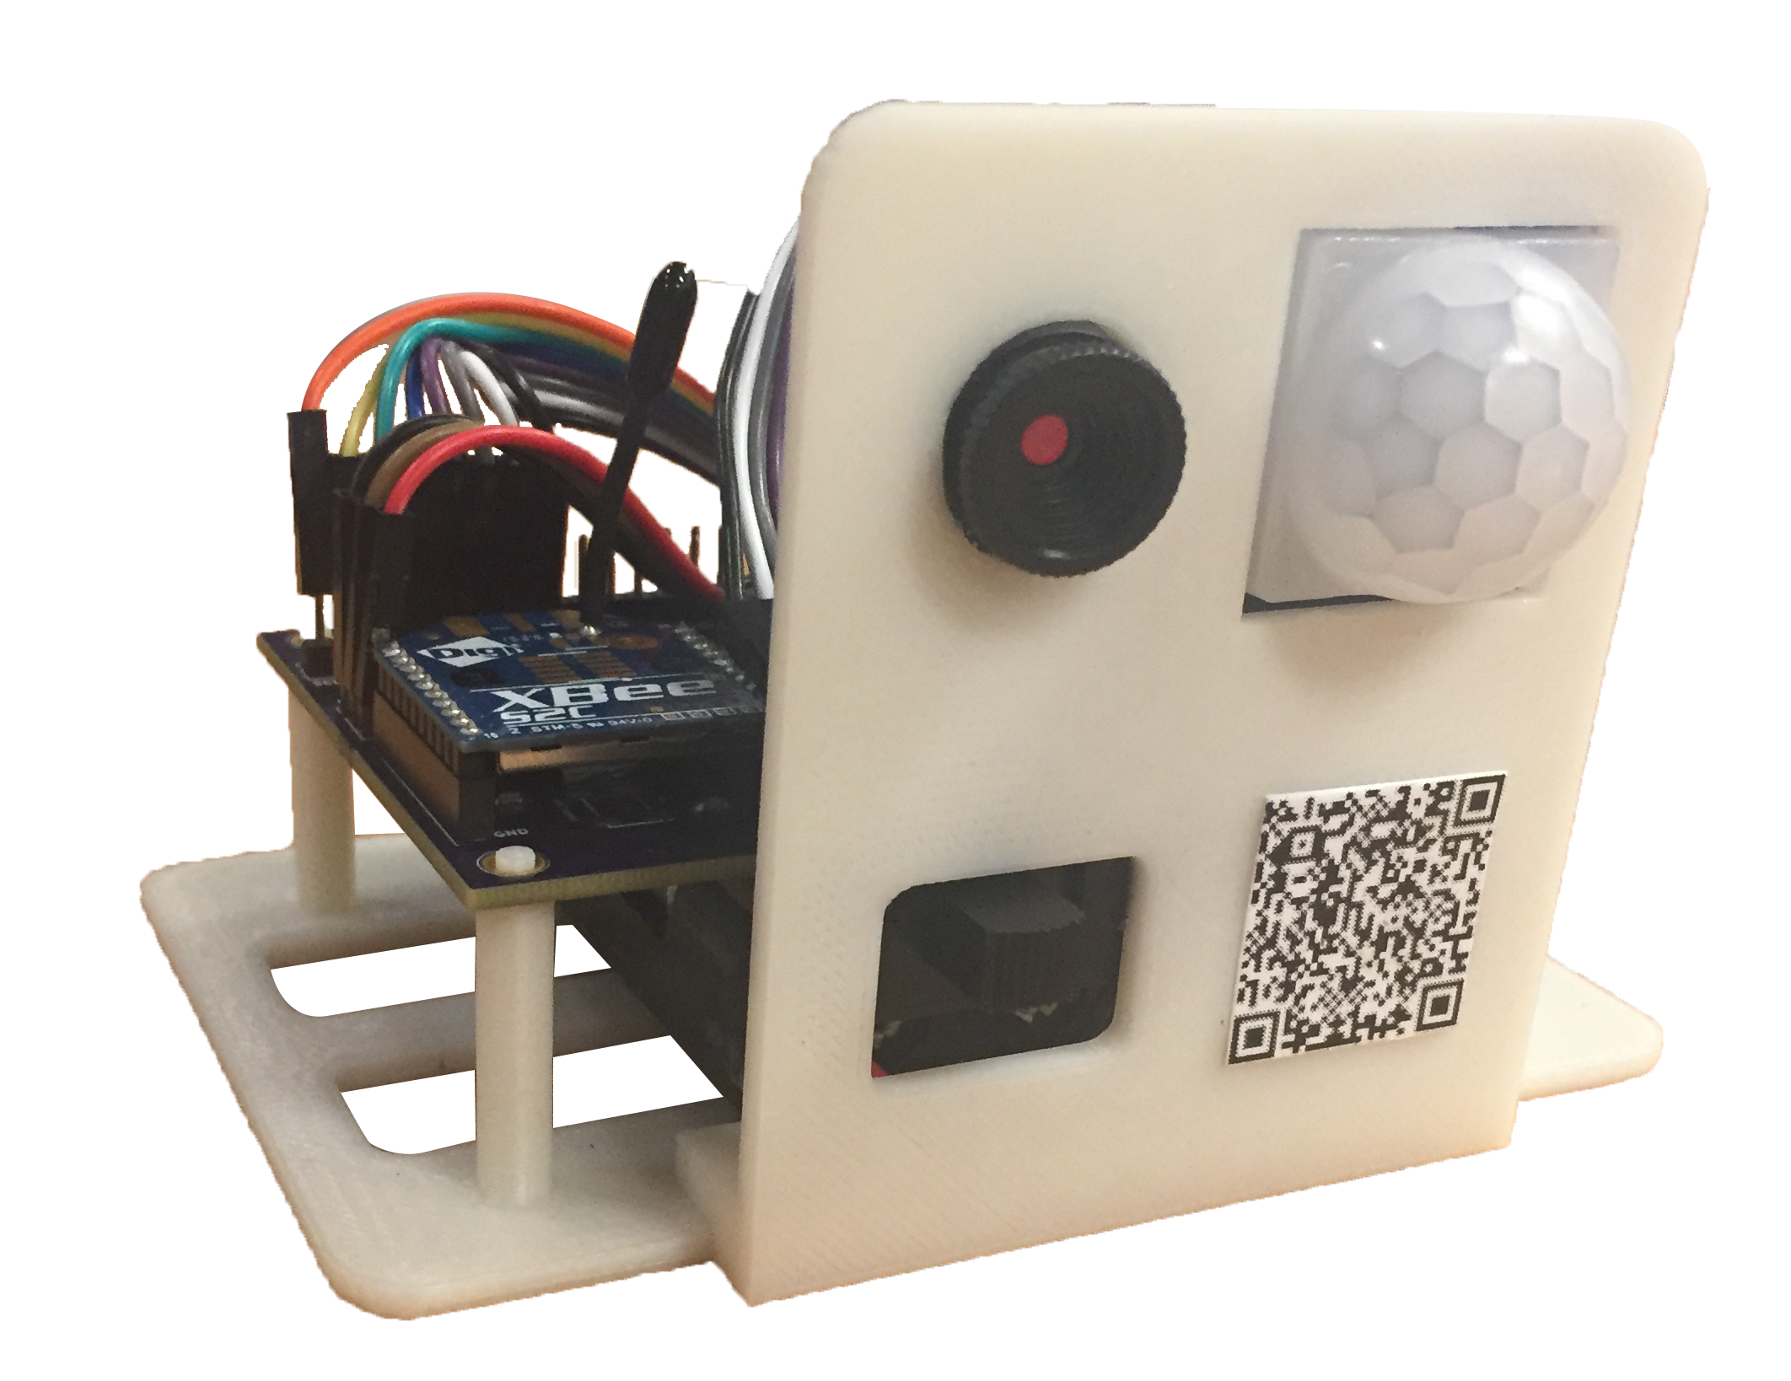
Prototype Design

Slide 20
Power Consumption – Normal Operation
Component | Operation | Current | Vcc | Power(w) | Expected Duty Cycle(min)
XBee S2C | Sleep | 0.3µA | 3.3V | 0.99µW | 94%
 | Transmit | 28mA | 3.3V | 92.4mW | 3%
 | Idle | 9mA | 3.3V | 2.97mW | 3%
PIR Sensor | Idle | 30µA | 3.3V | 99µW | 100%
Camera | Camera Shutdown w/MIC2090 | 5µA | 3.3V | 16.5uW | 100%
MSP432 | LPM3.5 | 15µA | 3.3V | 49.5µW | 94%
 | Active | 5mA | 3.3V | 16.5mW | 6%
Voltage Regulators | Active | 60µA |  |  | 100%
Average |  | 1.5mA | 3.3V | 4.95mW

Slide 21
Power Consumption – Image Capture
Component | Operation | Active/On | Vcc | Power(w) | Exp Duty Cycle(15s)
XBee S2C | Transmit | 28mA | 3.3V | 92.4mW | 90%
 | Sleep | 0.6µA | 3.3V | 1.98µW | 10%
PIR Sensor | Motion Detected | 80µA | 3.3V | 264µW | 7%
 | Idle | 30µA | 3.3V | 99µW | 93%
Camera | Active | 93mA | 3.3V | 306.9mW | 10%
 | Shutdown w/MIC2090 | 5µA | 3.3V | 16.5µW | 90%
MSP432 | Active | 5mA | 3.3V | 16.5mW | 100%
Average |  | 39.5mA | 3.3V | 130.5mW
Table to the left displays power results for motion triggered capture, which takes average of 15 seconds to complete
User Request has same power consumption except does not include power associated with PIR motion detected

Slide 22
Power Consumption – Projected Battery Life
Operation Mode | Current | Vcc | Power(w) | Exp Duty Cycle(day)
Normal | 1.5mA | 3.3V | 4.95mW | 99.65%
Capture Image | 39.5mA | 3.3V | 130.35mW | 0.35%
Average | 1.63mA | 3.3V | 5.37mW
Table to the left displays battery lifetime estimates with 20 pictures/day, and 3xAA batteries.
$$Battery Life=0.7∗\frac{6300mAh}{1.63mA}=2705hrs=112 days$$

Slide 23
Results Discussion
Key Management
Keys are regenerated on user request , and ran through the EL Gamal encryption scheme
Long battery life
Confirmed by lifetime of node based on power consumption of all components in
various modes , could be improved
Reprogrammable
Using FPGA to perform crypto key management
Easy Configuration
QR code scan for setup
Easy User Interface
App layout is easy to understand

Slide 24
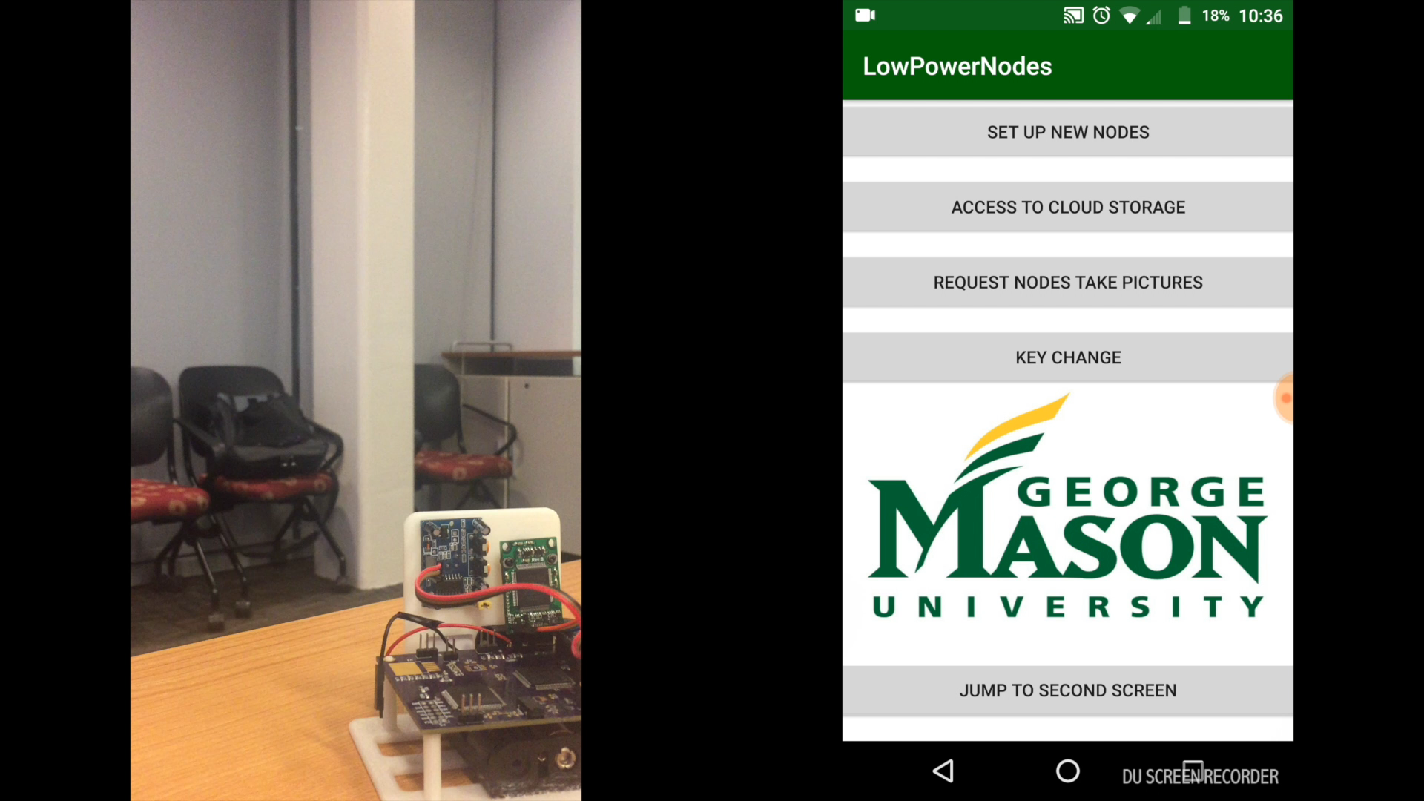
Demonstration

Slide 25
Man Hours and Contribution
Irfan (Project Manager): 250 Hours
BeagleBone Black
Python code to read serial data from XBee device and execute user requests between App and Node
MSP Development
Prototyping of sending and receiving from data from MSP with XBee
Logan : 300 Hours
MSP432 Development
C code to interface PIR sensor, camera and XBee module
PCB Design
Hung : 250 Hours
Android App Development
Select cloud server to customize with Android app and Beaglebone black.
Beaglebone black:
python code to communicate between cloud and BBB, detect new files and text message alert.
Ishak : 280 Hours
ECC El Gamal on the BeagleBone Black
Over the Air Rekeying
Slides
Jesse : 280 Hours
FPGA Development
VHDL code to interface to ECC Core and microcontroller
MSP Development
C code to interface microcontroller to FPGA
Mohammed : 285 Hours
Power circuit
Schematic / PCB
Testing
Total Hours : 1645 Hours

Slide 26
Funds Spent
Item | Quantity | Cost
Actel Igloo Nano Starter Kit | 1 | $100.00
FlashPro4 | 1 | $51.25
MSP430FR5994 | 1 | $25
CC2650 Launchpad | 1 | $29
MSP432 Launchpad | 2 | $26.36
OV2640 CMOS Sensor | 1 | $10.49
Arducam OV2640 | 1 | $25.99
HC-SR501 | 5 | $12.96
XBee S2C | 2 | $29.99
XBee breakout board | 1 | 10.00
PCB Cost | 3 | $70
BeagleBone Black | 1 | $50
 | Total: | $411.04
Item | Quantity | Cost
AGLN250V2-VQG100 | 1 | $16.11
Arducam OV2640 | 1 | $25.99
HC-SR501 PIR | 1 | $1.69
XBee S2C | 1 | $17.50
MSP432P401R | 1 | $5.29
LT1129 | 1 | $2.92
PCB | 1 | $7.93
Other Components | 1 | $5.00
 | Total | $82.43

Slide 27
Lessons Learned
Start prototyping early.
Buy multiple quantities of everything you need.
Technical Changes
Replace MSP432 and XBee, with either CC2630.
Replace Arducam OV2640 with less expensive OV2640 and on-board Igloo FPGA and SDRAM.
Use MIC2090 to turn on/off camera.

Slide 28
Thank You
Dr. Jens-Peter Kaps
Ahmad Salman
Dr. Kai Zeng
Dr. Pachowicz

Slide 29
Sources
http://elinux.org/Beagleboard:BeagleBoneBlack
https://www.google.com/search?q=goldman+sachs+IoT&rlz=1C1CHZL_enUS687US687&source=lnms&tbm=isch&sa=X&ved=0ahUKEwjP27LMt8fTAhWa8oMKHaHACGoQ_AUICygC&biw=1745&bih=819#imgrc=emT8O80KZOguvM:
http://www.tinyosshop.com/index.php?route=product/product&product_id=1012
https://www.digikey.com/product-detail/en/microsemi-corporation/AGLN-NANO-KIT/1100-1136-ND/2745083

Slide 30
Questions

